Slide 1
Parallel Computing of Graph-based Functions in Re-RAM
Ali Akbar
Abdulaziz Almekhy
alHamdan Aljbairi

Slide 2
ROADMAP
Introduction
BDD and AIG
Graph based Representation
RERAM MAC operation
Graph based computation in ReRAM
Types of Parallelism
BDD parallel computation
AIG parallel computation
M-AIG parallel computation
Conclusion

Slide 3
Introduction
CMOS approaches its physical boundaries due to the continuous shrinking feature size
Search for promising emerging technologies beyond scaling limit has sped up
Advancement of future low power, leakage free and nanoscale electronic systems
Resistive Random Access Memory (ReRAM) is a non-volatile memory technology
Attracted a high amount of attention among the emerging post-CMOS device technologies

Slide 4
Introduction
ReRam Features
Low power consumption
Inherent computing capabilities
Efficiency of logic synthesis
Maximization of parallel computation
Limiting number of memory accesses allowed
Binary Decision Diagram (BDD)
And-Inverter Graph (AIG)
M-And-Inverter Graph (M-AIG)

Slide 5
BDD
BDD-based synthesis approach for ReRAM crossbars
Utilizes Multiply-Accumulate (MAC) operation instead of logic primitives
Implication
Majority function
Proposed approach first optimizes BDDs using an evolutionary algorithm
Directly maps the BDD nodes represented by multiplexers onto parallel MAC operations realized in crossbar columns.

Slide 6
AIG
Automated compiling procedure
An in-memory computer architecture based on regular ReRAM crossbar arrays
Translates arbitrary Boolean functions
Executable by applying appropriate voltage levels
Execution of bit-level parallel computational instructions

Slide 7
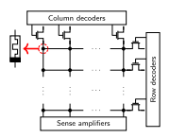
Graph-based Representation
Graph-based representations of Boolean functions
BDDs
AIGs
Plays an important role in synthesis.
AIGs are representations of Boolean networks.
The edges represent wires between two-input AND gates that correspond to the nodes
The edges can be complemented to represent inverters between the nodes

Slide 8

ReRAM MAC Computation
Applications such as neural networks and neuromorphic computing
Perform a lot of matrix multiplications
An efficient implementation of the MAC operation is needed
ReRAM provides the basis for such an efficient implementation,
Compute multiple MAC operations in parallel
Consider the ReRAM crossbar in matrix, computes I = Ax

Slide 9
Graph Based Computation in ReRAM
Existing approaches have tried to find efficient ways of mapping
MIGs need the smallest number of operations and devices
They have become the state-of-the art graph structure for ReRAM-based synthesis.
Existing approaches do neither focus on parallel computations, nor do they use the MAC operation

Slide 10
Types of Parallelism
Parallel computations perform on a ReRAM array
Addressing multiple wordlines or bitlines simultaneously
A computation is wordline parallel if it uses one wordline and multiple bitlines;
A computation is bitline parallel if it uses one bitline and multiple wordlines;
A computation is mixed parallel if it uses multiple wordlines and multiple bitlines.

Slide 11
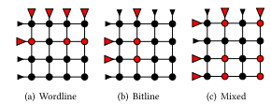
Types of Parallelism
Row and column drivers are represented by triangles
Active devices are shown in red and slightly enlarged
The ReRAM devices in which a computation takes place are highlighted in red
Mixed parallel computation has to deal with data distortion

Slide 12
Types of Parallelism
Even the small computation cannot be performed if only one of the six activated devices contains a value that must not be overwritten
Problem becomes more severe as more lines are activated
It is unfeasible to make efficient use of this parallelism in general when performing RM3-based computations
Bitline parallel computation cannot deal with inversions efficiently, which are central to most logic representations
Bitline is naturally inverted but the wordline and the internal resistance state are not

Slide 13
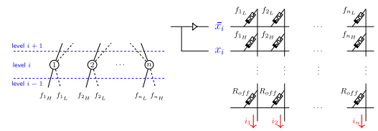
BDD-based Parallel Computation
To compute a BDD on a ReRAM crossbar, every node has to be realized as a 2x1 multiplexer designating Boolean relation
The nodes at ith BDD level use an identical input variable of the target function as select line
Representing a function with N input variables using an initial ascending variable ordering

Slide 14
AIG-based Parallel Computation
Computing two MIG-nodes in parallel within a wordline we have to respect four constraints
All children of both nodes must be computed. In particular, there must not be any data dependencies between the nodes.
The nodes must share a wordline operand.
The host devices of the nodes must be placed in the same wordline.
The content of the host devices must not be necessary for any other computations.

Slide 15
AIG-based Parallel Computation
Keep the number of required ReRAM devices as low as efficient parallelism allows
Keep track of whether the content of a device is still needed
Call the set of free devices in a word a hole
The devices in a hole can be reused instead of allocating new ones
Filling a small hole in a word is computationally inefficient
Primary Inputs (PIs) are present in the memory array

Slide 16
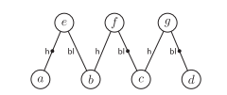
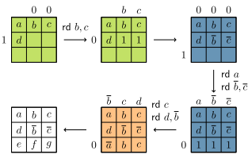
AIG-based Parallel Computation
The AIG levels computes successively
Place and compute the inverted values necessary for this level
Place the nodes of the level and initialize the devices with the corresponding host operands.
Compute the nodes themselves by scheduling the computations that have host devices in the same word in parallel.

Slide 17
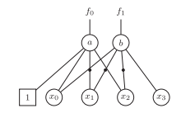
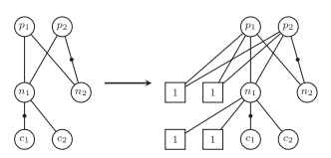
M-AIG-based Parallel Computation
Each node represents an m-Input And Gate or a PI
Each input edge can either be connected to the constant 1 or to a child node
If the input edge is connected to a node, then the edge may be complemented to indicate inversion
AIGs are a subset of m-AIGs, m-AIGs are not canonical

Slide 18
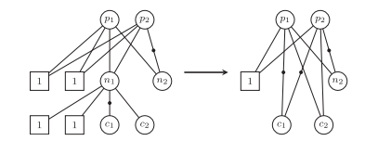
M-AIG-based Parallel Computation
Add m-2 inputs to each node that is not a PI of the AIG
Each additional input is connected to the constant 1.
Add the inputs to each node
Simplify using a bottom-up approach in the second step by merging nodes

Slide 19
Conclusion
Proposed approach significantly reduces the number of devices
Reduces operations needed
It needs almost the same number of devices but reduces the number of operations by about 66% on average
BDD and AIG outperform in both area and operation
Efficiency of m-AIG has shown
For small values of m, m-AIG has outperform AIG

Slide 20
References
F. SAM, “Parallel Computing of Graph Based Functions in ReRAM”, Article 21, January 2022, 24 pages, doi.org/10.1145/34531863
S. Yasuda, “A Copper ReRAM cell for storage Classic Memory Applications”, June 2014
V. Srinivasan, “Diode Based Bipolar ReRam Selectors”, IEEE vol. 03, no 10. pp 1396, October 2021, doi:10.1109/LED
Y. Hong, “Vertical cross point resistance change memory for ultra high density non volatile memory application”, July 2009

